Slide 1
Aaron Riggs, Andre Manz, Chris Baierski, Wesley Scott as
DrinkTank Present
Phil The automated bartender (SDS)

Slide 2
What is PHIL again?
P.H.I.L.
Please Have Infinite Liquor
Goals
Reduce operating cost and loss for a bar to operate under rush conditions.
Reduce the amount of drinks that are over poured and spilled.
Reduce the amount of menial drinks that are made by the bartender.

Slide 3
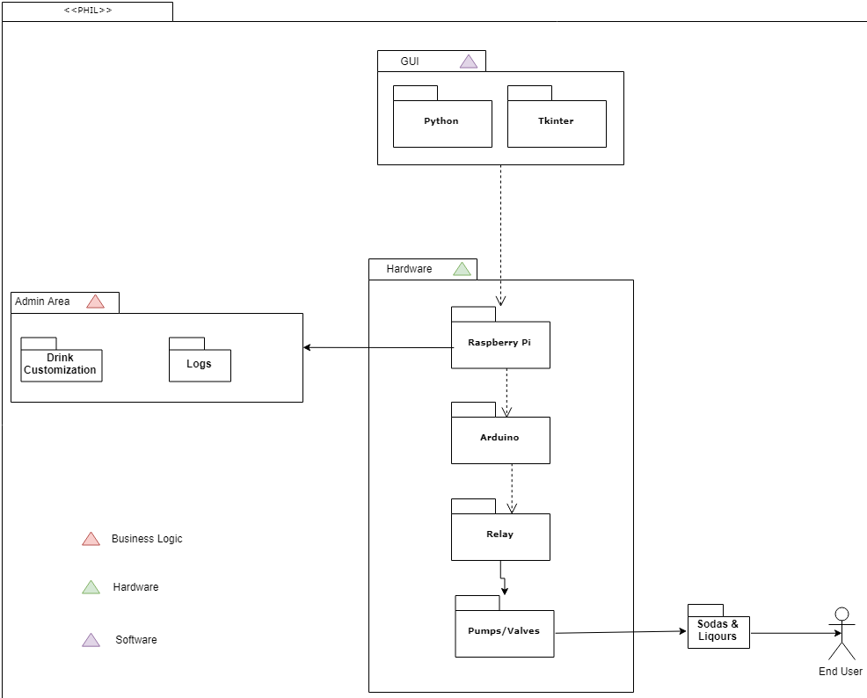
System decomposition and analysis
Software
Python
Tkinter
Rasbean
Hardware
Raspberry Pi
Arduino
Relay
Dell Power Supply
Pumps, Valves, hoses

Slide 4
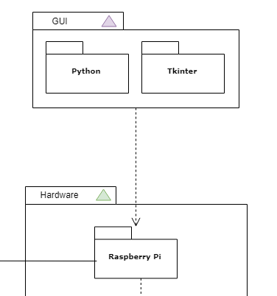
GUI is the highest level
Interfaces directly with the hardware
Via Raspberry Pi and touchscreen

Slide 5
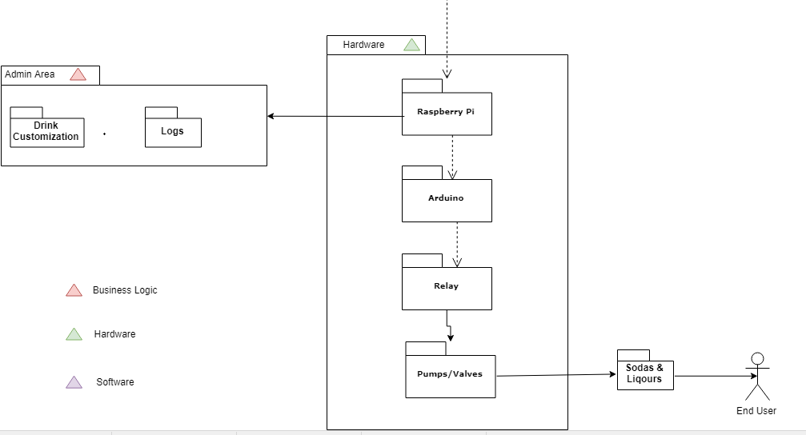

Slide 6
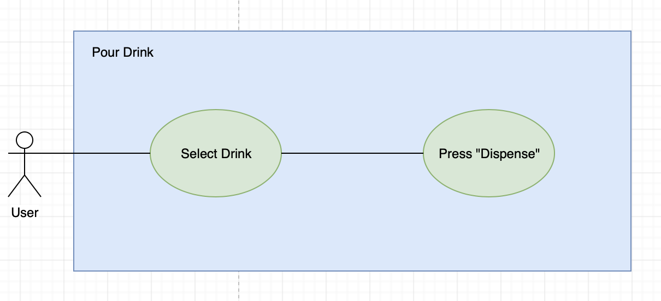
UML use case diagrams

Slide 7
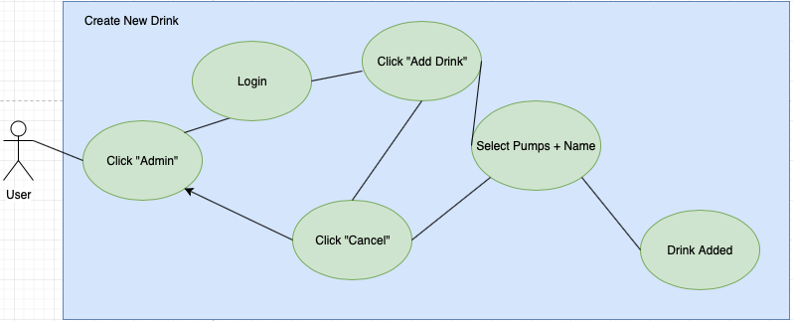
UML use case diagrams

Slide 8
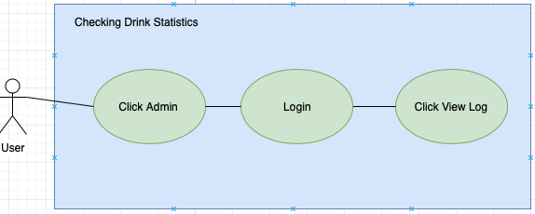
UML use case diagrams

Slide 9
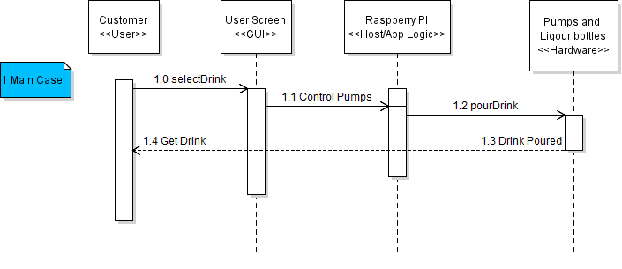
UML sequence diagram - main

Slide 10
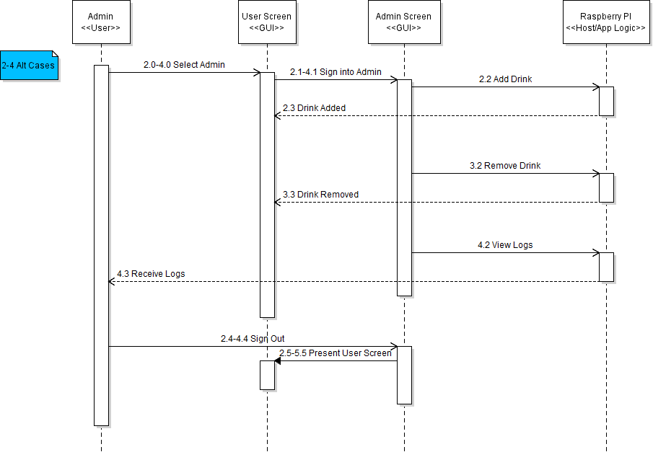
UML sequence diagram - alt

Slide 11
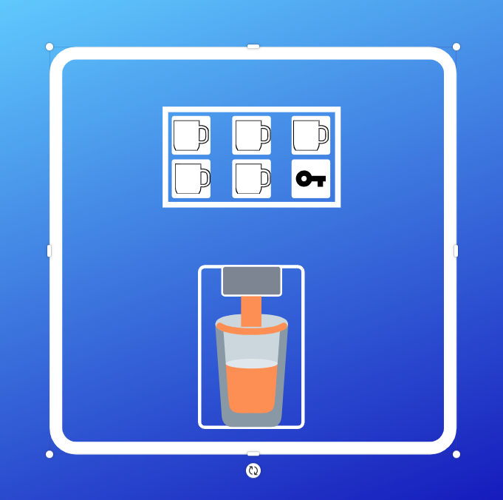
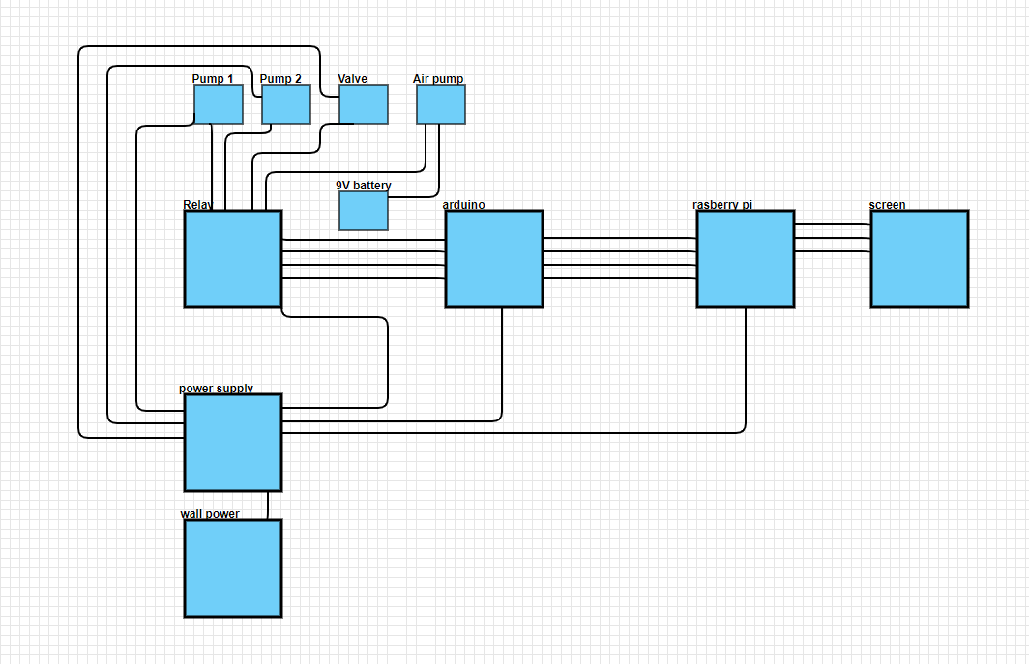
Low fidelity prototypes

Slide 12
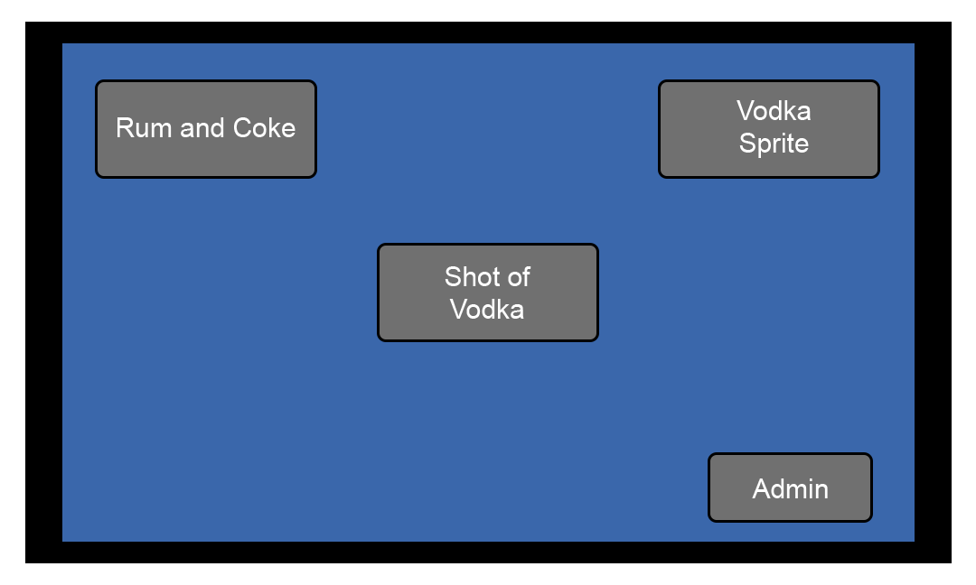
Low fidelity prototypes

Slide 13
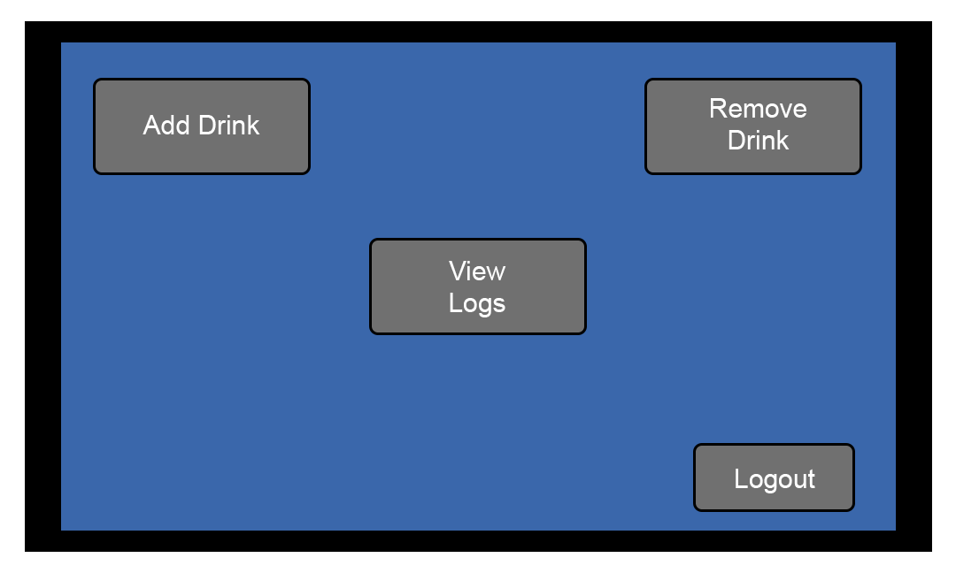
Low fidelity prototypes

Slide 14
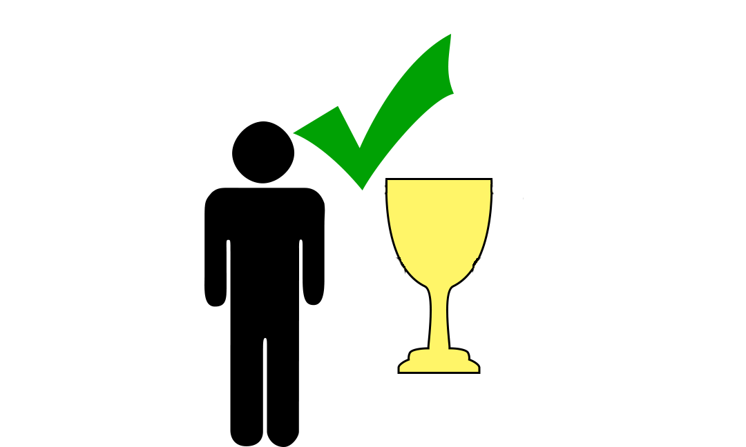

Slide 15

PHIL is making drinks

Slide 16
Continuing Development
GUI improvements
Fix leaking on the soda line
Touch screen Implementation
GUI testing
Full scale test (Making drinks until the soda is empty)
Internal DB w/ SQLite
Drink statistics logging

